Slide 1
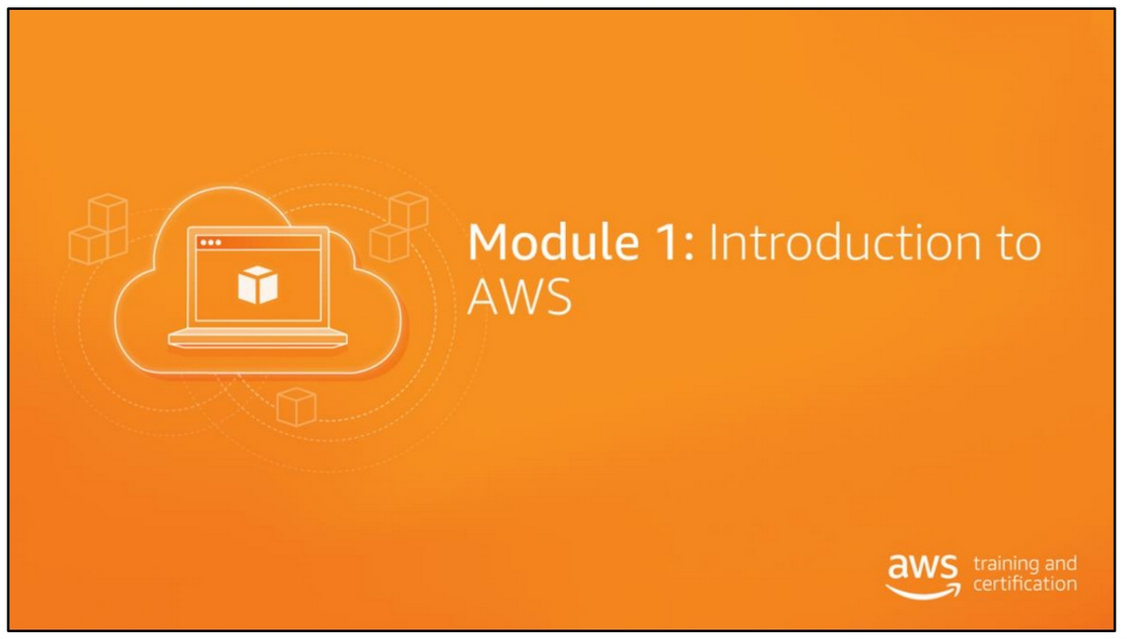

Slide 2
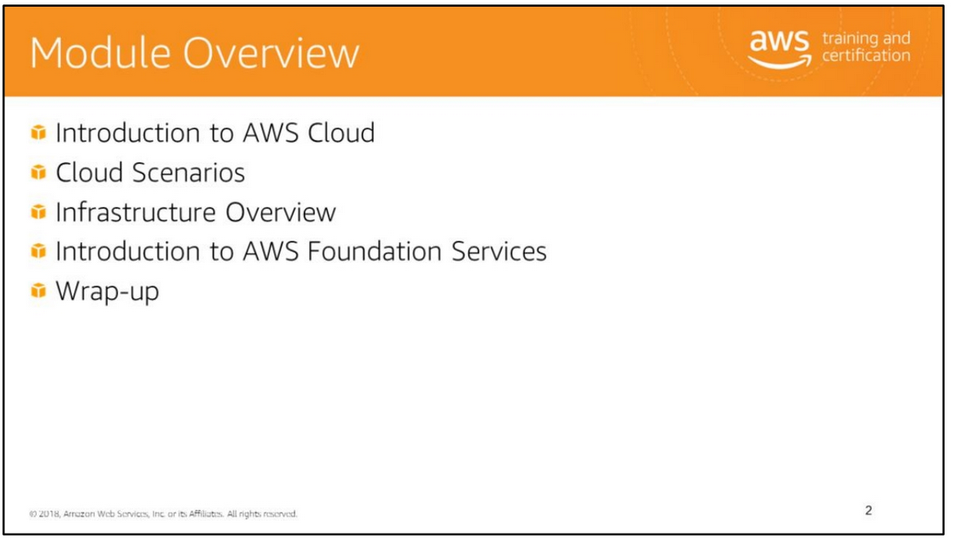

Slide 3
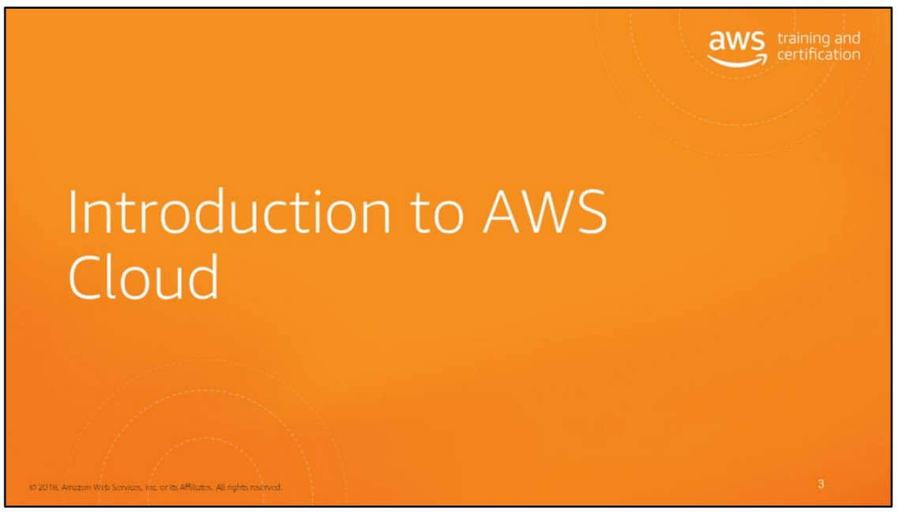

Slide 4
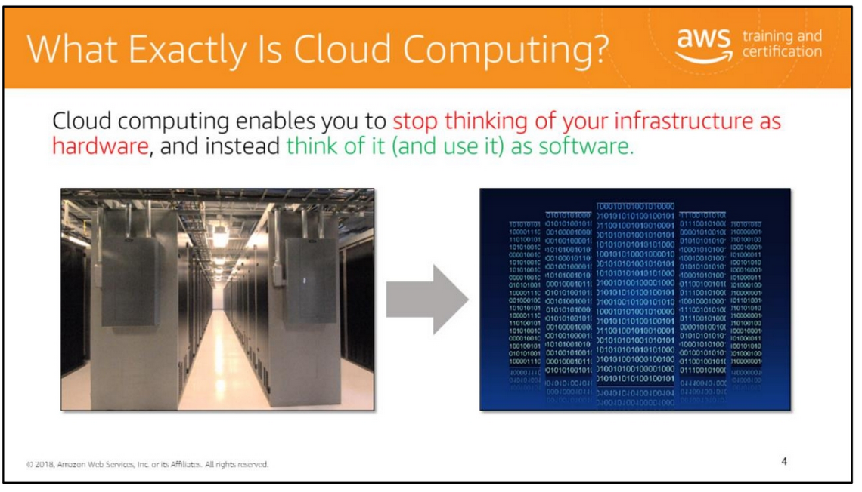
“Computing" is a term broadly used to define the on-demand delivery of IT resources and applications via the Internet, with pay-as-you-go pricing.
Accessing and using your infrastructure as software offers a number of benefits. Primary among them is the flexibility it provides. With a cloud services provider such as AWS, you don't have to worry about anticipating your hardware needs ahead of time and then ordering, installing, and setting it up at your data center. Similarly, since you can provision and terminate resources as necessary on AWS, you don't have to keep paying for hardware you don't need in case your needs change.
For more on this, see https://aws.amazon.com/what-is-cloud-computing

Slide 5
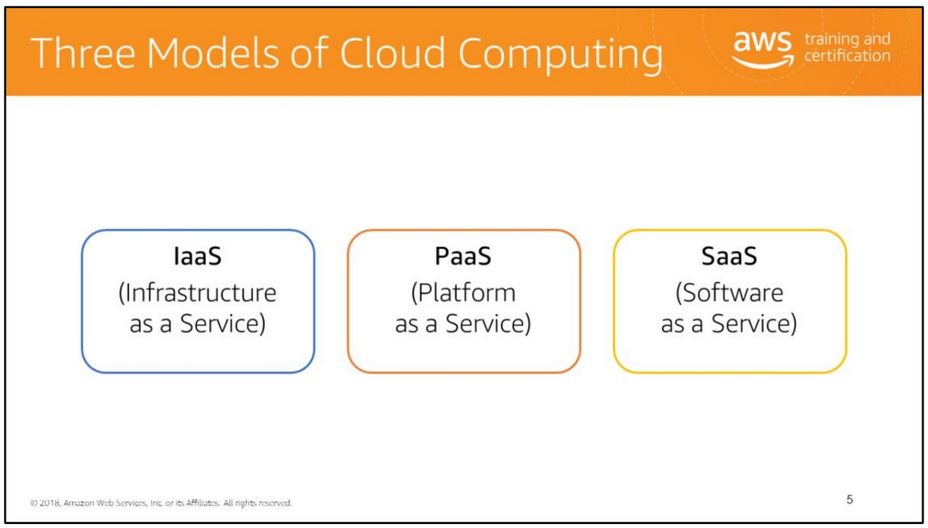
Cloud services can fall into one of three primary categories, based mainly around how much control (and responsibility) you have over how the service is configured.
IaaS (Infrastructure as a Service) Basic building blocks for cloud IT: • Networking features • Computers • Data storage space
PaaS (Platform as a Service) Enables you to run applications without the need to manage underlying infrastructure (i.e., hardware and operating systems).
SaaS (Software as a Service) Provides you with a completed product that is run and managed by the service provider.

Slide 6
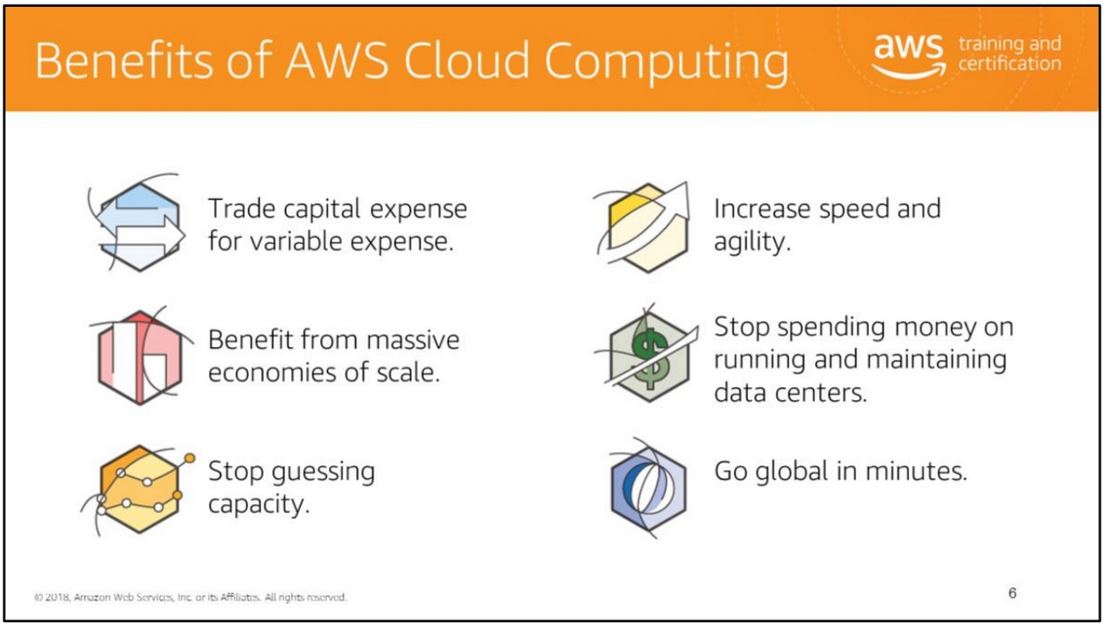
Cloud computing provides a simple way to access servers, storage, databases, and a broad set of application services over the Internet. AWS owns and maintains the network-connected hardware required for these application services, while you provision and use what you need via a web application.
Trade capital expense for variable expense Instead of investing heavily in data centers and servers before you know how you’re going to use them, you can pay only when you consume computing resources and pay only the amount you consume.
Benefit from massive economies of scale By using cloud computing, you can achieve a lower variable cost than you can get on your own. Because usage from hundreds of thousands of customers is aggregated in the cloud, providers such as Amazon Web Services can achieve higher economies of scale, which translates into lower pay-as-you-go prices.
Stop guessing capacity Eliminate guessing about your infrastructure capacity needs. When you make a capacity decision before deploying an application, you often end up either sitting on expensive idle resources or dealing with limited capacity. With cloud computing, these problems go away. You can access as much or as little as you need and scale up and down as required with only a few minutes’ notice

Slide 7
Increase speed and agility In a cloud computing environment, new IT resources are only ever a click away, which means you reduce the time it takes to make those resources available to your developers from weeks to just minutes. This results in a dramatic increase in agility for the organization, because the cost and time it takes to experiment and develop is significantly lower.
Stop spending money on running and maintaining data centers
Focus on projects that differentiate your business, not the infrastructure. Cloud computing lets you focus on your own customers, instead of on the heavy lifting of racking, stacking, and powering servers.
Go global in minutes Easily deploy your application in multiple regions around the world with just a few clicks. This means you can provide a lower latency and better experience for your customers simply and at minimal cost.

Slide 8
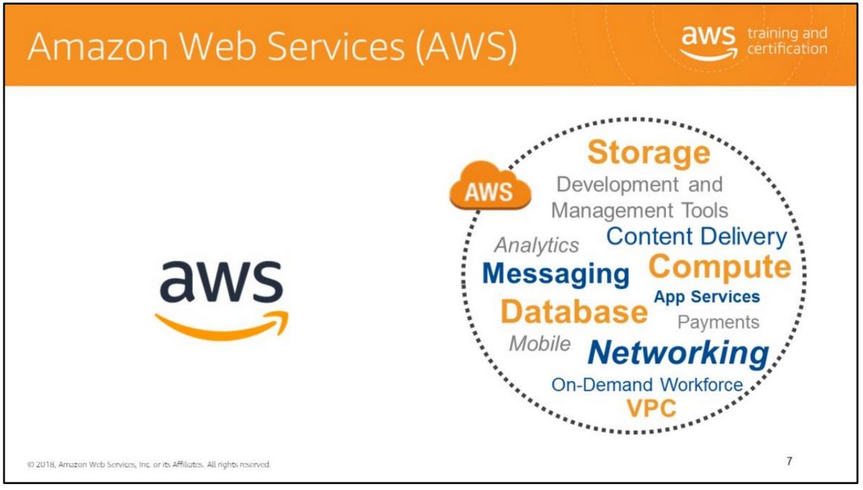
Amazon Web Services is 10+ years in the making. Amazon Web Services, also abbreviated to AWS, is a collection of remote computing services called web services. These web services make up a cloud computing platform offered via the Internet. We deliver web-based cloud services for storage, computing, networking, databases, and more.
The AWS mission is to enable businesses and developers to use web services to build scalable, sophisticated applications. Web services is another name for what people now call “the cloud.”
For more information, see http://aws.amazon.com.

Slide 9
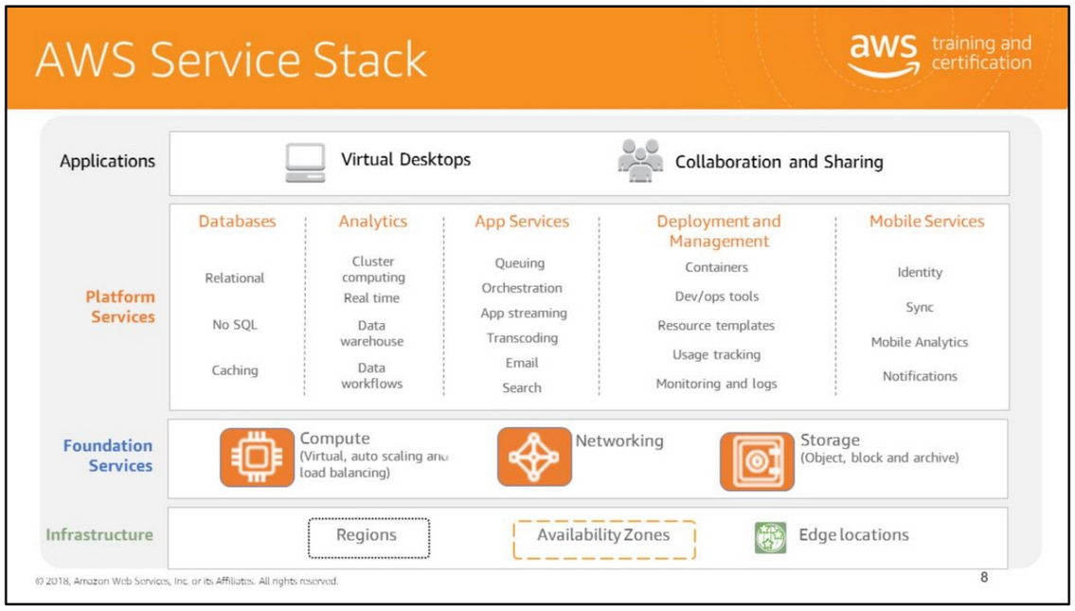
Amazon Web Services offers a broad set of global compute, storage, database, analytics, application, and deployment services that help organizations move faster, lower IT costs, and scale applications. These services are trusted by the largest enterprises and the hottest start-ups to power a wide variety of workloads including web and mobile applications, IoT, data processing and warehousing, storage, archive.
AWS cloud computing provides a simple way to access servers, storage, databases, and a broad set of application services over the internet. AWS owns and maintains the network-connected hardware required for these application services, while you provision and use what you need.

Slide 10
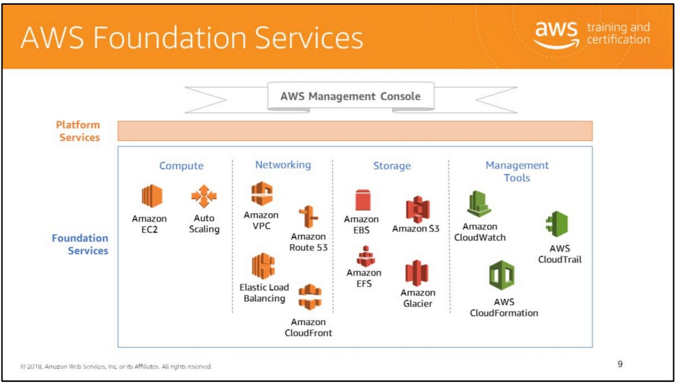
AWS provides several foundation services to help run your application in the cloud. AWS services can be broadly grouped into the following categories:
Compute: Amazon Elastic Compute Cloud (EC2) is the linchpin of AWS compute services. EC2 reduces the time required to obtain and boot new server instances to minutes, which allows you to quickly scale capacity, both up and down, as your computing requirements change. The EC2 service can be combined with Elastic Load Balancing and Auto Scaling services to develop a high availability and high performance infrastructure for your applications.
Networking: The networking group of services provides a DNS service, gives you direct control over your virtual networking environment on AWS, and enables you to interact with Amazon EC2 instances as if they were within your existing network.
Storage: AWS provides several storage options that correspond to the type of usage and data.

Slide 11
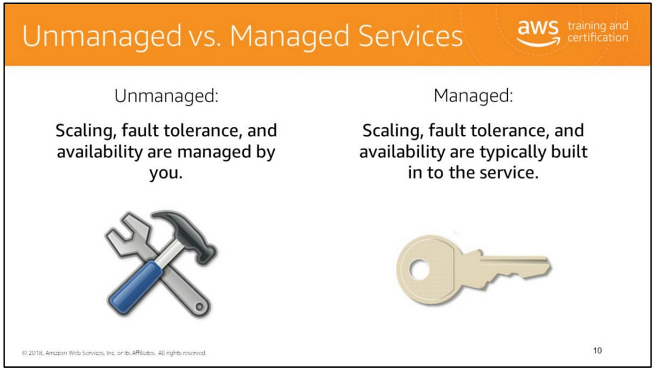
AWS solutions typically fall into one of two categories: "unmanaged" or "managed.”
Unmanaged services are typically provisioned in discrete portions as specified by you. Unmanaged services require the user to manage how the service responds to changes in load, errors, and situations where resources become unavailable. For instance, if you launch a web server on an Amazon EC2 instance, that web server will not scale to handle increased traffic load or replace unhealthy instances with healthy ones unless you specify it to use a scaling solution such as Auto Scaling, because Amazon EC2 is an "unmanaged" solution.
However, if you have a static website that you're hosting in a cloud-based storage solution such as Amazon S3 without a web server, those features (scaling, fault-tolerance, and availability) would be automatically handled internally by Amazon S3, because it is a managed solution. Managed services still require the user to configure them (for example, creating an Amazon S3 bucket and setting permissions for it); however, managed services typically require far less configuration.
The benefit to using an unmanaged service, however, is that you have more fine-tuned control over how your solution handles changes in load, errors, and situations where resources become unavailable.

Slide 12
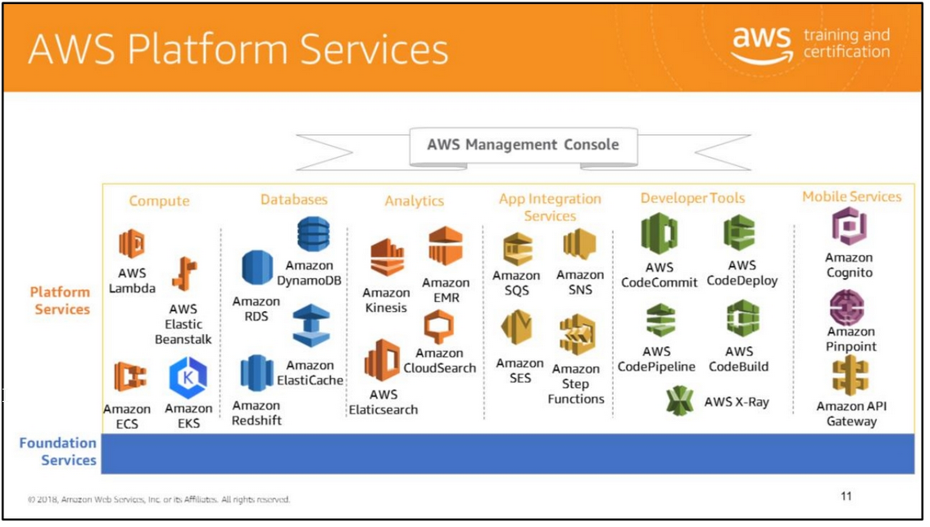
AWS offers several platform services that enable you to develop and deploy applications in the cloud. The platform services can be grouped into the following categories:
Databases: AWS has several options to store data based on the type and usage of data. You can use RDS to work with relational databases, ElastiCache to cache frequently accessed data, DynamoDB to function as a NoSQL database, and Amazon Redshift for data warehouse capabilities.
Analytics: Amazon Kinesis, Amazon EMR, and related services enable you to analyze vast amounts of data (big data).
Development Tools: AWS CodeCommit, a source control service, in combination with deployment services like AWS CodeDeploy, AWS Elastic Beanstalk, and AWS CloudFormation, enables you to implement robust release practices with a strong DevOps model.
Mobile: AWS offers mobile services such as Amazon SNS for notifications, Amazon Cognito for authentication and saving mobile user data, and Amazon Mobile Analytics to measure and analyze mobile application usage data.

Slide 13
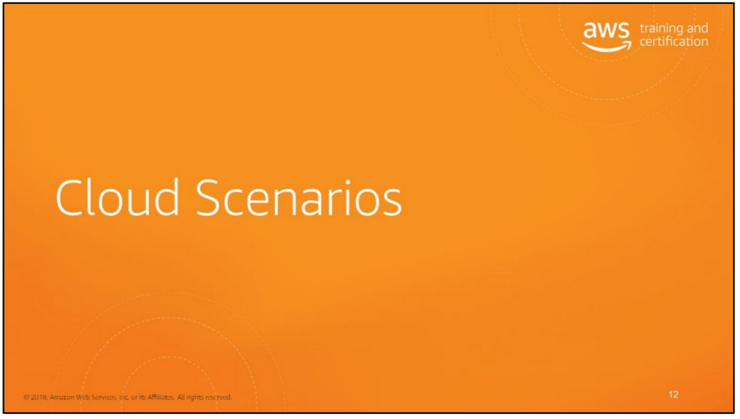

Slide 14
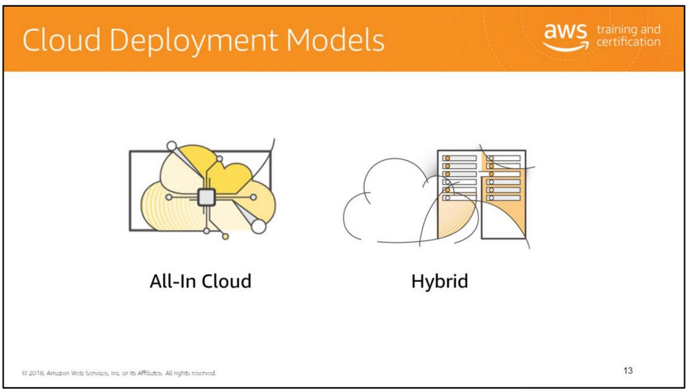
All-In Cloud A cloud-based application is fully deployed in the cloud and all parts of the application run in the cloud. Applications in the cloud have either been created in the cloud or have been migrated from an existing infrastructure to take advantage of the benefits of cloud computing. Cloud-based applications can be built on low-level infrastructure pieces or can use higher level services that provide abstraction from the management, architecting, and scaling requirements of core infrastructure.
Hybrid A hybrid deployment is a way to connect infrastructure and applications between cloud-based resources and existing resources that are not located in the cloud. The most common method of hybrid deployment is between the cloud and existing “on-prem” (On-premises: technology that is located within the physical confines of an enterprise – often in the company's data center) infrastructure to extend, and grow, an organization's infrastructure into the cloud while connecting cloud resources to internal system.
For more information on how AWS can help you with your hybrid deployment, see https://aws.amazon.com/enterprise/hybrid/.

Slide 15
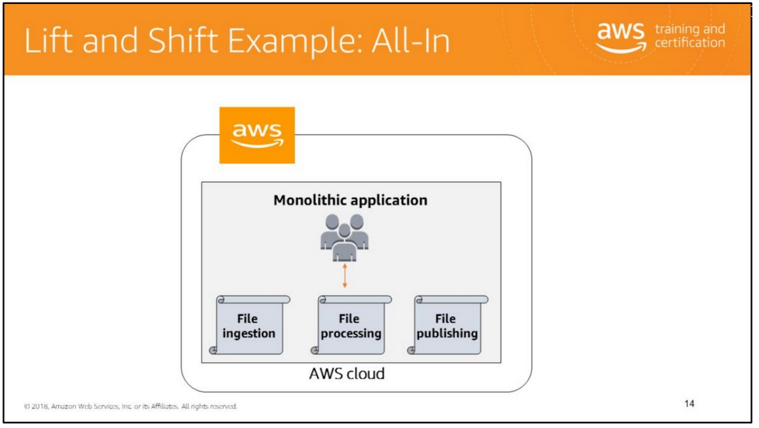
With cloud adoption becoming the new normal for the enterprise, the next-level debate is now about the specific approach to take when migrating to the cloud. While it is usually not difficult to achieve consensus on a “cloud first” strategy for all new capabilities delivered, rarely do the same parties easily agree on a common approach to the hundreds or thousands of existing applications that still reside in company data centers. Teams responsible for effecting an enterprise’s transition to the cloud might initially find it easier to apply a one-size-fits-all approach and cut through devolving debates about risks and dependencies, but that approach could also jeopardize the trust and cooperation of the application owners they are asking to migrate.
Yet many enterprise cloud teams have been successful earning this trust and cooperation while also delivering on aggressive timelines in so-called “lift-and-shift” cloud migrations, where the goal is to move a specific set of applications to the cloud as fast as possible without changing their core architecture, functionality, or performance characteristics. This is no small challenge since some application development teams will have the opinion that their software will require substantial refactoring to run in the cloud, while others don’t want to bring their technical debt to a pristine new cloud environment.

Slide 16
The fundamental notion of software refactoring is to change application code for the better.

Slide 17
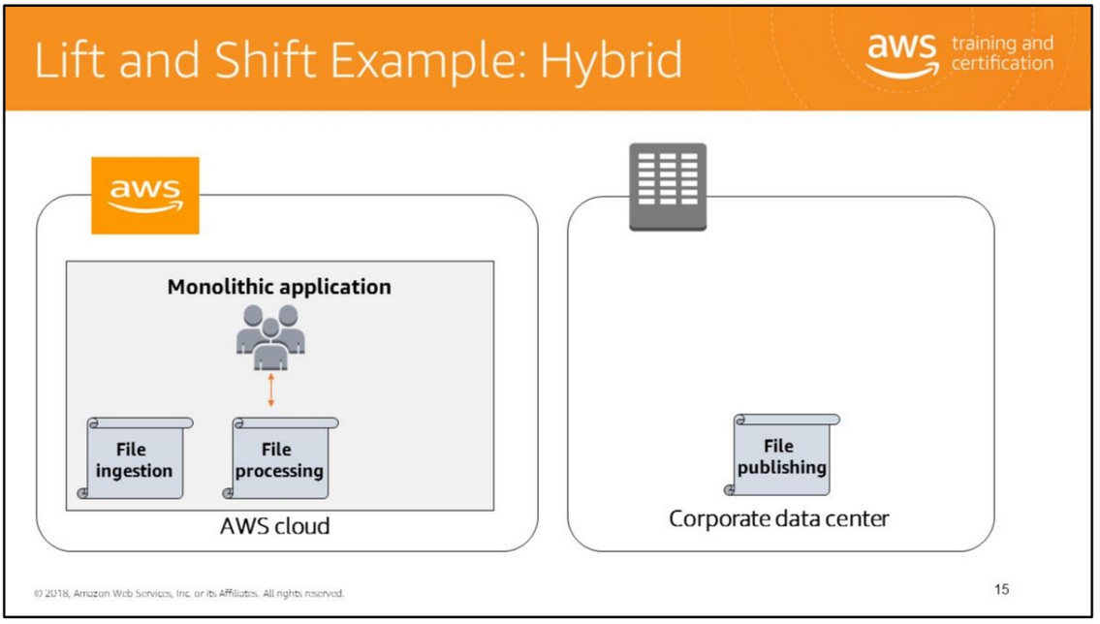
At the most fundamental level, hybrid computing can be viewed as having data that resides both on-premises and in the cloud. This is often done to economically store large data sets, utilize new cloud-native databases, move data closer to customers, or to create a backup and archive solution with cost-effective high availability. In all cases, AWS offers a range of storage and database services that can work together with your on-premises applications to store data reliably and securely.

Slide 18
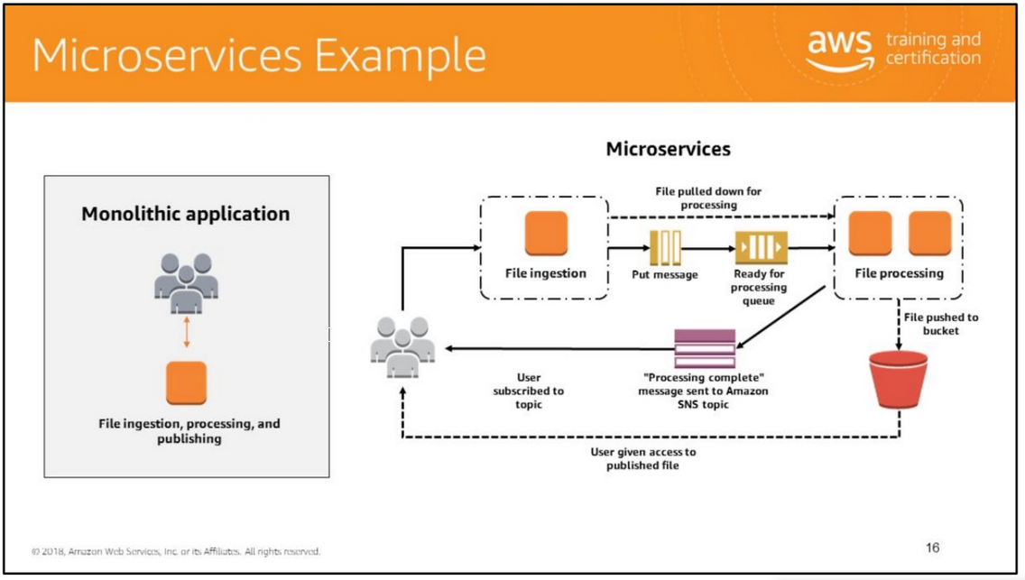
Traditional monolithic architectures are hard to scale. As an application's code base grows, it becomes complex to update and maintain. Introducing new features, languages, frameworks, and technologies becomes very hard, limiting innovation and new ideas.
Within a microservices architecture, each application component runs as its own service and communicates with other services via a well-defined API. Microservices are built around business capabilities, and each service performs a single function. Microservices can be written using different frameworks and programming languages, and you can deploy them independently, as a single service, or as a group of services.
Microservices allow you to choose the best technology for your workload. For example you might use in-memory cache such as Memcached or Redis for fast access to your data, but in another service you might be better served with a traditional relational database. Same goes for your chosen programming language and other technology choices: remaining flexible about them is both a benefit and a mandate.

Slide 19
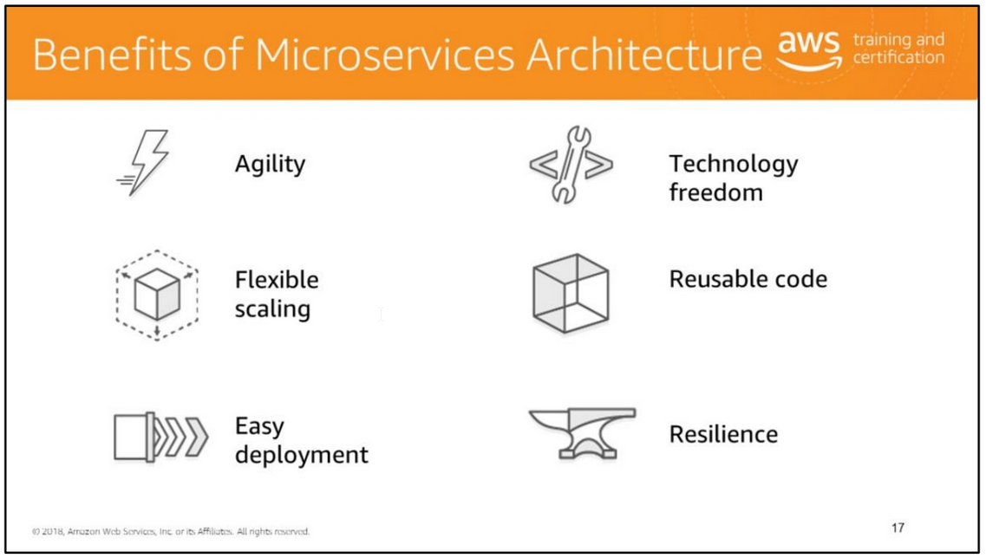
Agility
Microservices foster an organization of small, independent teams that take ownership of their services. Teams act within a small and well understood context, and are empowered to work more independently and more quickly. This shortens development cycle times. You benefit significantly from the aggregate throughput of the organization.
Flexible scaling
Microservices allow each service to be independently scaled to meet demand for the application feature it supports. This enables teams to right-size infrastructure needs, accurately measure the cost of a feature, and maintain availability if a service experiences a spike in demand.
Easy deployment
Microservices enable continuous integration and continuous delivery, making it easy to try out new ideas and to roll back if something doesn’t work. The low cost of failure enables experimentation, makes it easier to update code, and accelerates time-to-market for new features.

Slide 20
Technological freedom
Microservices architectures don’t follow a “one size fits all” approach. Teams have the freedom to choose the best tool to solve their specific problems. As a consequence, teams building microservices can choose the best tool for each job.
Reusable code
Dividing software into small, well-defined modules enables teams to use functions for multiple purposes. A service written for a certain function can be used as a building block for another feature. This allows an application to bootstrap off itself, as developers can create new capabilities without writing code from scratch.
Resilience Service
independence increases an application’s resistance to failure. In a monolithic architecture, if a single component fails, it can cause the entire application to fail. With microservices, applications handle total service failure by degrading functionality and not crashing the entire application.

Slide 21
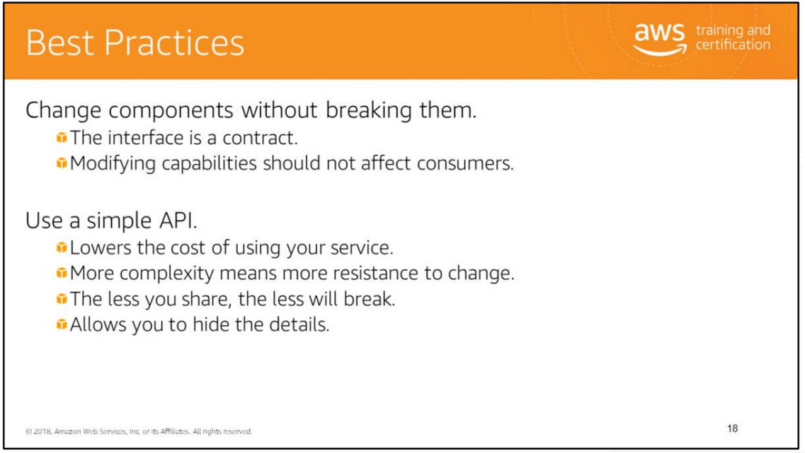
In order to replicate the business domain you need to integrate the services that you have built. How can you do this in the best possible fashion? First, always be aware that you are maintaining a contract with your subscribers/clients. You want to iterate faster but not break functionality in the process. The interface is crucial. You need to be considerate of other teams that depend on your product.
Second, make the API as simple as possible. This way it will be easier to maintain and change later. Because interfacing is so important, choosing a unified solution for all this inter-service communication to occur is tempting. Be careful to avoid integrating with smart, controlling, complex middleware which would force tighter coupling.

Slide 22
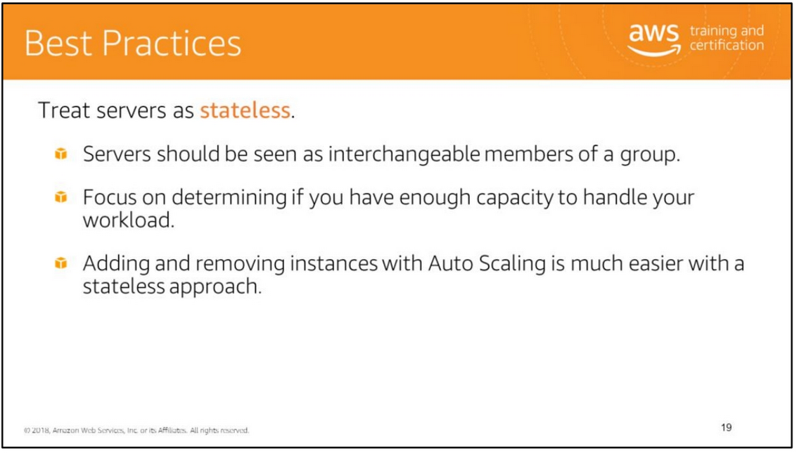

Slide 23
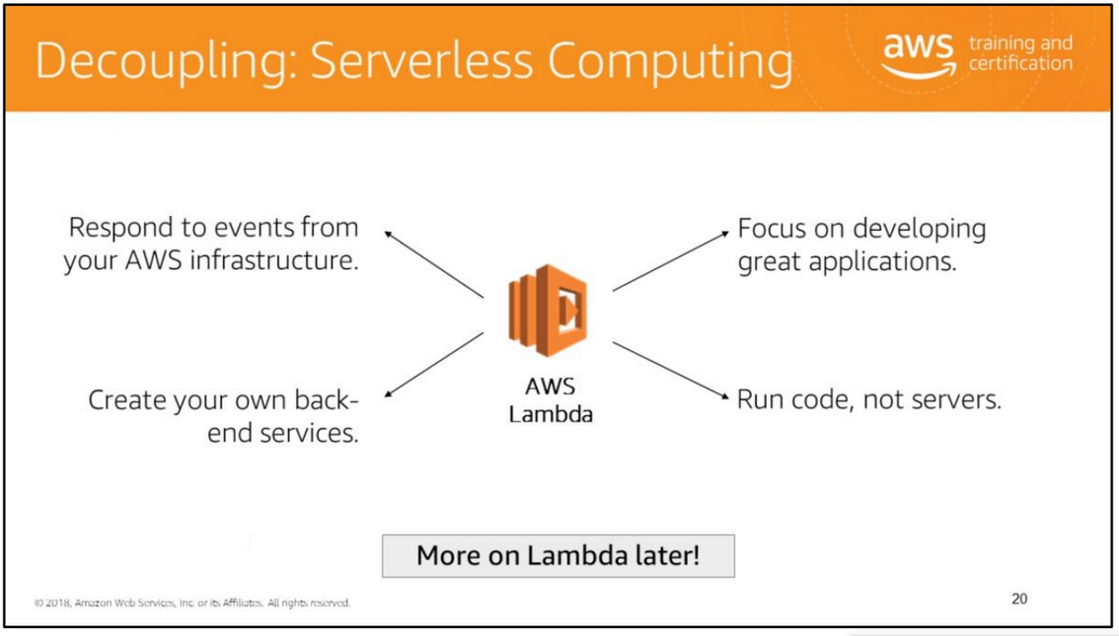
AWS Lambda is a serverless compute service that runs your code in response to events and automatically manages the underlying compute resources for you. You can use AWS Lambda to extend other AWS services with custom logic, or create your own back-end services that operate at AWS scale, performance, and security. AWS Lambda can automatically run code in response to multiple events, such as HTTP requests via Amazon API Gateway, modifications to objects in Amazon S3 buckets, table updates in Amazon DynamoDB, and state transitions in AWS Step Functions.

Slide 24
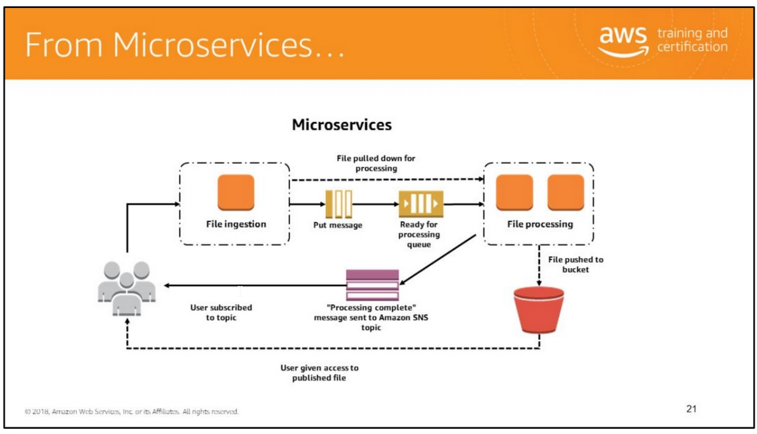
The microservices architecture is a design approach to build a single application as a set of small services. Each service runs in its own process and communicates with other services through a well-defined interface using a lightweight mechanism, typically an HTTP-based application programming interface (API). Microservices are built around business capabilities; each service is scoped to a single purpose. You can use different frameworks or programming languages to write microservices and deploy them independently, as a single service, or as a group of services.

Slide 25
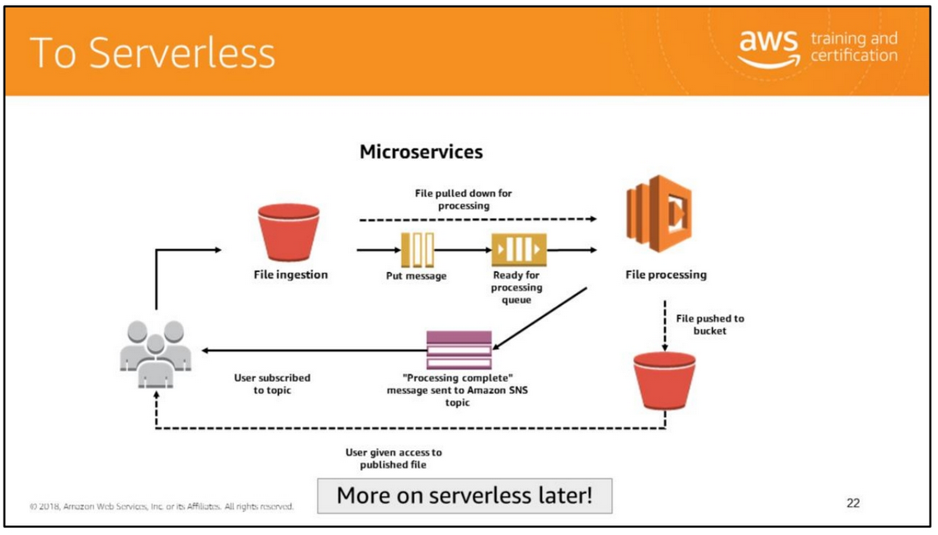
Serverless most often refers to serverless applications. Serverless applications are ones that don't require you to provision or manage any servers. You can focus on your core product and business logic instead of responsibilities like operating system (OS) access control, OS patching, provisioning, right-sizing, scaling, and availability. By building your application on a serverless platform, the platform manages these responsibilities for you.

Slide 26
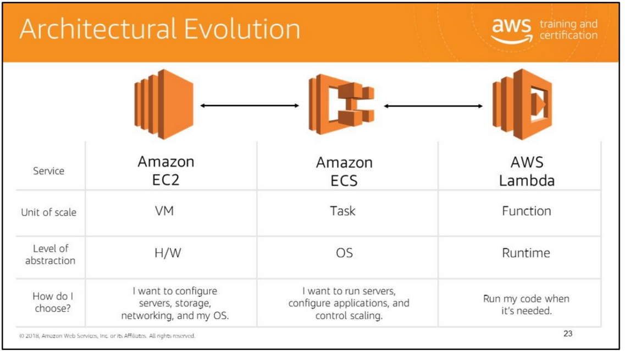

Slide 27
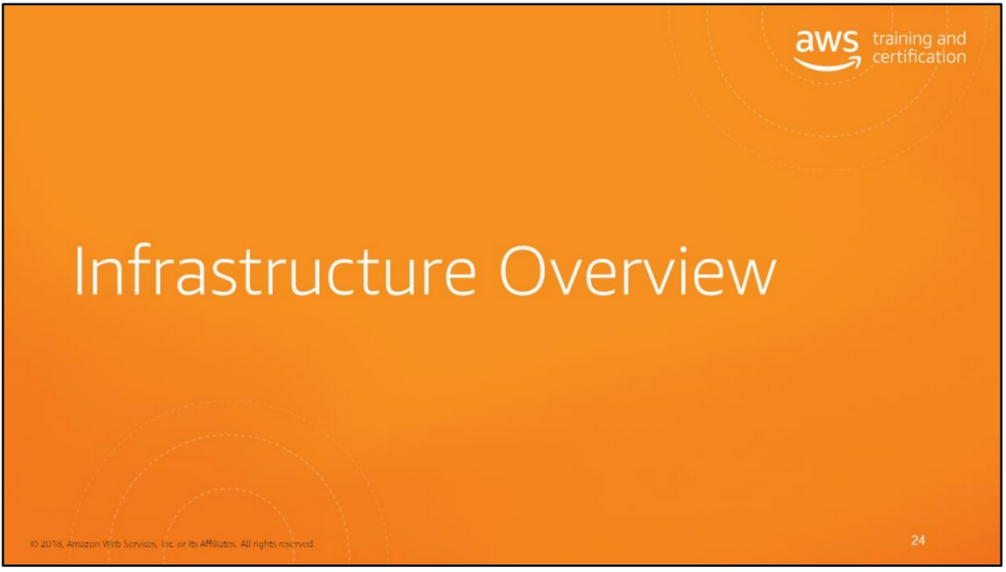

Slide 28
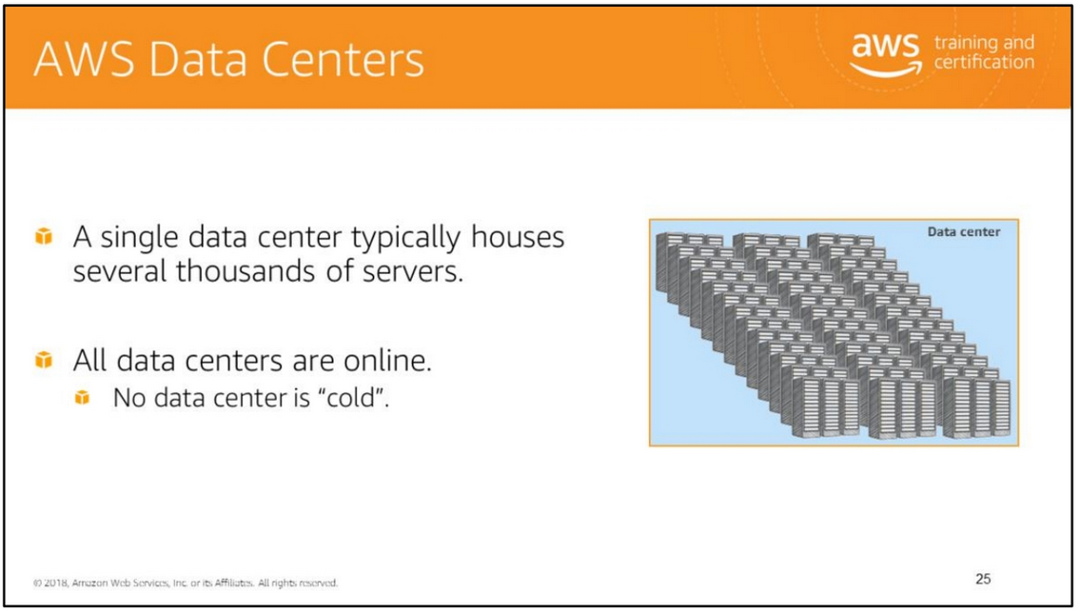
AWS data centers are built in clusters in various global regions. Larger data centers
are undesirable; All data centers are online and serving customers; no data center is “cold”; in case of failure, automated processes move customer data traffic away from the affected area. Core applications are deployed in an N+1 configuration, so that in the event of a data center failure, there is sufficient capacity to enable traffic to be load-balanced to the remaining sites.

Slide 29
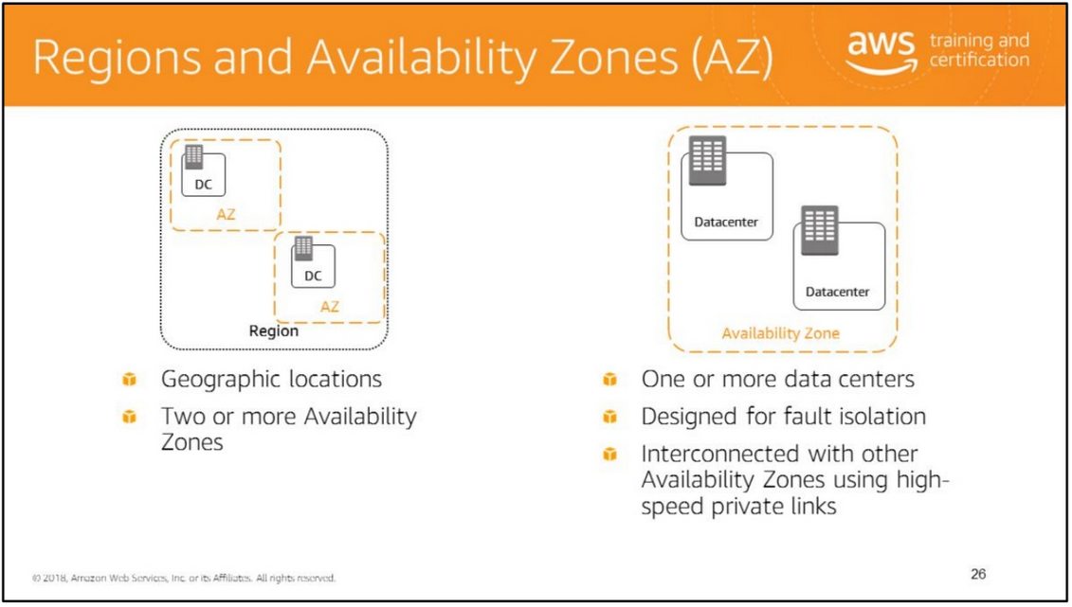
AWS Regions are geographic locations that contain multiple Availability Zones (AZs).
Availability Zones consist of data centers clustered in a region. Each Availability Zone is engineered to be isolated from failures in other Availability Zones. Each AZ is isolated, but the AZs in a region are connected through low-latency links. Where natural disasters or fault lines are a consideration, AWS isolates its Availability Zones so that they are not easily affected at the same time. For example, where earthquakes are a problem AWS would not build two AZs on the same fault line.
When you launch an instance, you can select an AZ or let AWS choose one for you. If you distribute your instances across multiple AZs and one instance fails, you can design your application so that an instance in another AZ can handle requests. AWS highly recommends provisioning your compute resources across multiple Availability Zones. If you have multiple instances, you can run them across more than one AZ and get added redundancy. If a single AZ has a problem, all assets in your second AZ will be unaffected.

Slide 30
comprises one or more data centers, with some Availability Zones having as many as six data centers. However, no data center can be part of two Availability Zones.
Each Availability Zone is designed as an independent failure zone. This means that Availability Zones are physically separated within a typical metropolitan region and are located in lower-risk flood plains (specific flood-zone categorization varies by region). In addition to having discrete uninterruptable power supply and onsite backup generation facilities, they are each fed via different grids from independent utilities to further reduce single points of failure. Availability Zones are all redundantly connected to multiple tier-1 transit providers.
You are responsible for selecting the Availability Zones where your systems will reside. Systems can span multiple Availability Zones. You should design your systems to survive temporary or prolonged failure of an Availability Zone if a disaster occurs. Distributing applications across multiple Availability Zones allows them to remain resilient in most failure situations, including natural disasters or system failures.
For more information, see: • http://aws.amazon.com/about-aws/global-infrastructure/regional-product-services/
• http://docs.aws.amazon.com/AWSEC2/latest/UserGuide/using-regions-availability-zones.html
• https://www.amazonaws.cn/en/

Slide 31
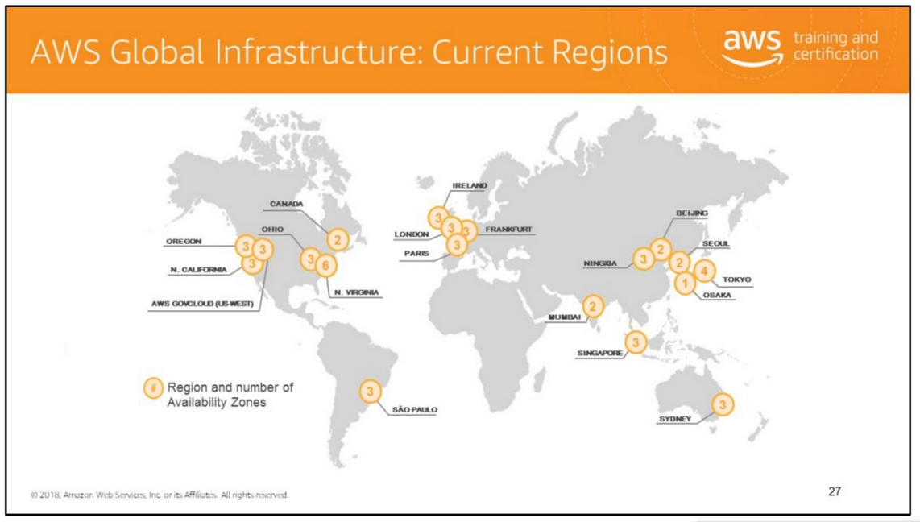
comprises one or more data centers, with some Availability Zones having as many as six data centers. However, no data center can be part of two Availability Zones.
Each Availability Zone is designed as an independent failure zone. This means that Availability Zones are physically separated within a typical metropolitan region and are located in lower-risk flood plains (specific flood-zone categorization varies by region). In addition to having discrete uninterruptable power supply and onsite backup generation facilities, they are each fed via different grids from independent utilities to further reduce single points of failure. Availability Zones are all redundantly connected to multiple tier-1 transit providers.
You are responsible for selecting the Availability Zones where your systems will reside. Systems can span multiple Availability Zones. You should design your systems to survive temporary or prolonged failure of an Availability Zone if a disaster occurs. Distributing applications across multiple Availability Zones allows them to remain resilient in most failure situations, including natural disasters or system failures.
For more information, see: • http://aws.amazon.com/about-aws/global-infrastructure/regional-product-services/
• http://docs.aws.amazon.com/AWSEC2/latest/UserGuide/using-regions-availability-zones.html
• https://www.amazonaws.cn/en/

Slide 32
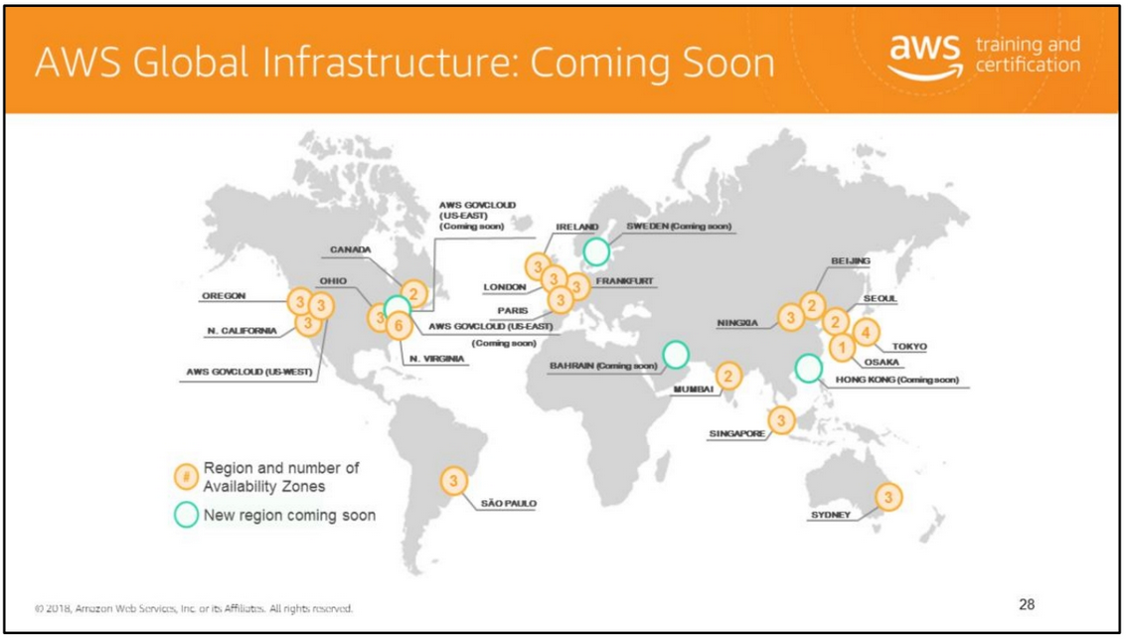
The AWS Cloud spans 55 Availability Zones within 18 geographic Regions and 1 Local Region around the world, with announced plans for 12 more Availability Zones and four more Regions in Bahrain, Hong Kong SAR, Sweden, and a second AWS GovCloud Region in the US.
For more information about global infrastructure, see http://aws.amazon.com/about-aws/globalinfrastructure/.

Slide 33
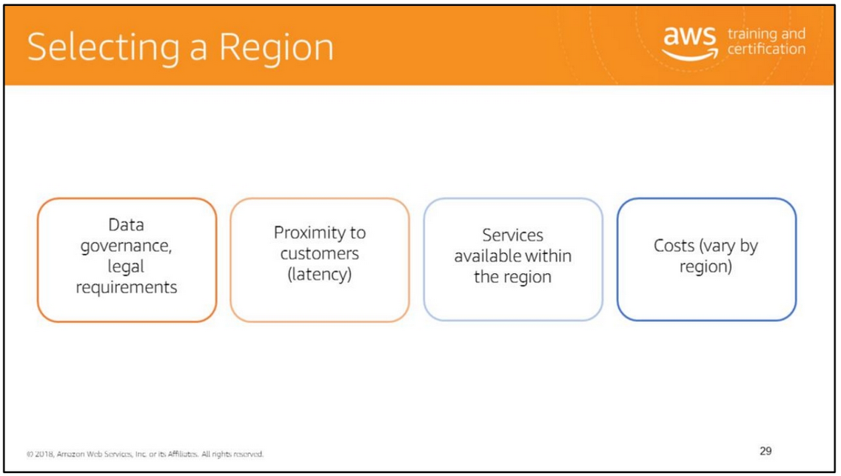
Determine the right region for your services, applications, and data based on these factors. To ensure high performance for your customers, select the region closest to them, thereby minimizing latency. • Sometimes, local laws will require that certain information be kept within the geographical boundaries of a country. Such laws may restrict the regions in which you can offer content or services.
• New AWS services tend to roll out gradually across regions. Check the Products and Services by Region chart (http://aws.amazon.com/about-aws/global-infrastructure/regional-product-services/) to determine whether a region offers the services required by your system.
• CloudPing (test latency between your location and all AWS regions): http://www.cloudping.info/

Slide 34
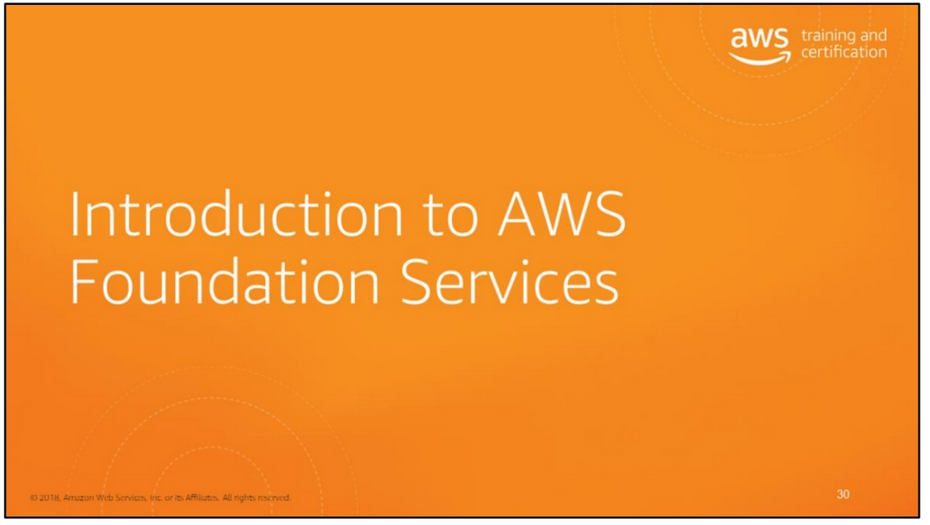

Slide 35
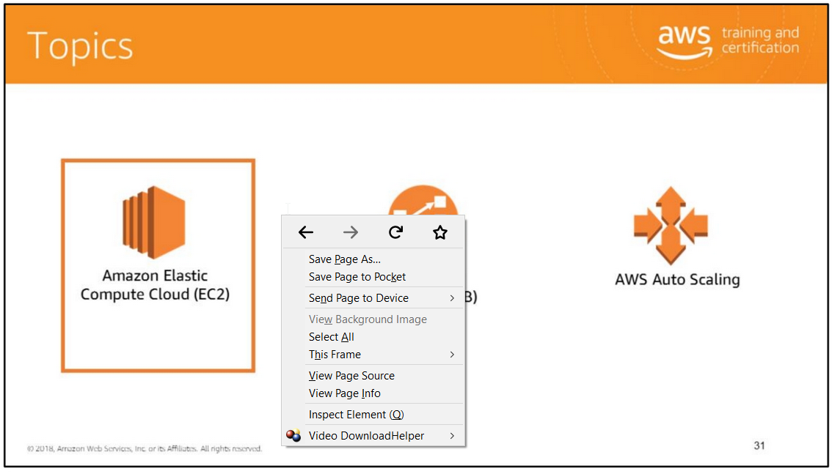
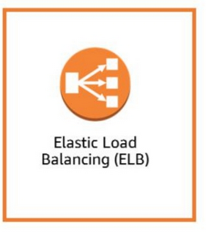
The compute services that will be covered in this module are:
• EC2
• ELB
• AWS Auto Scali

Slide 36
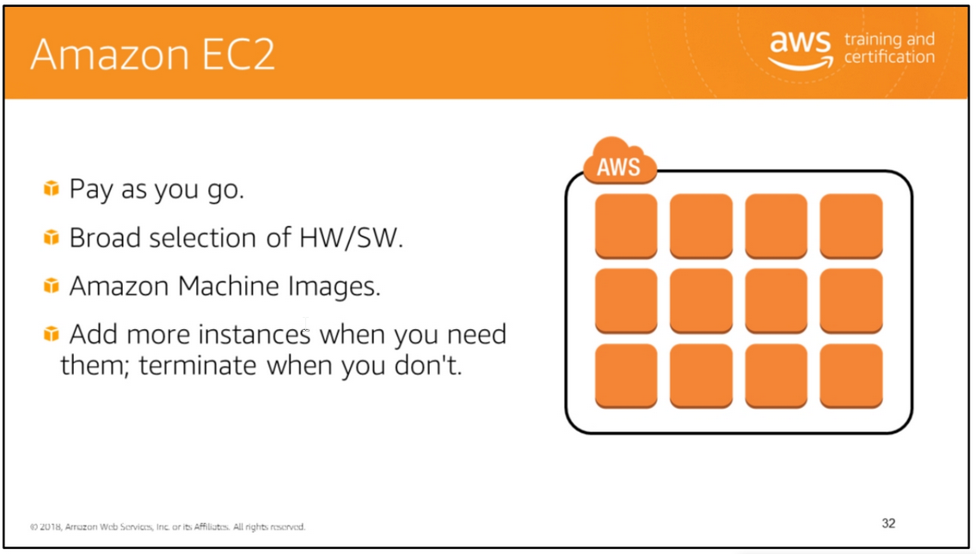
Amazon EC2 is essentially a computer in the cloud. Virtually anything you can do with a server, you can do with an Amazon EC2 instance. When combined with the other services from AWS, which Amazon EC2 is optimized to work with, it enables you to do even more. Most server operating systems are supported: Windows 2003, 2008, and 2012, Red Hat, SUSE, Ubuntu, and Amazon Linux.
You can create images of your servers at any time with a few clicks or a simple API call. These images are referred to as AMIs (Amazon Machine Images) and can be reused to launch instances in the future.
You can launch one instance or an entire fleet of instances with a few clicks or a simple API call. EC2 instances in Amazon Virtual Private Cloud (VPC) now offer native support for the IPv6 protocol. IPv6 can be enabled for existing and new VPCs through the AWS management console, API/SDK and CLI.
Scalable. Add more instances when you need them; terminate them when you don't. Optimizable: Choose from instance types optimized for CPU, memory, storage,

Slide 37
networking capacity, and graphics, and general purpose. Each instance type has a variety of sizes.
But let's stop calling them servers and use the proper name of Amazon EC2 instances. Instances are pay-as-you-go. You pay for running instances and for the time that they're running. Provided with Amazon EC2 instances are a broad selection of hardware and software, and selection of where to host your instances.

Slide 38
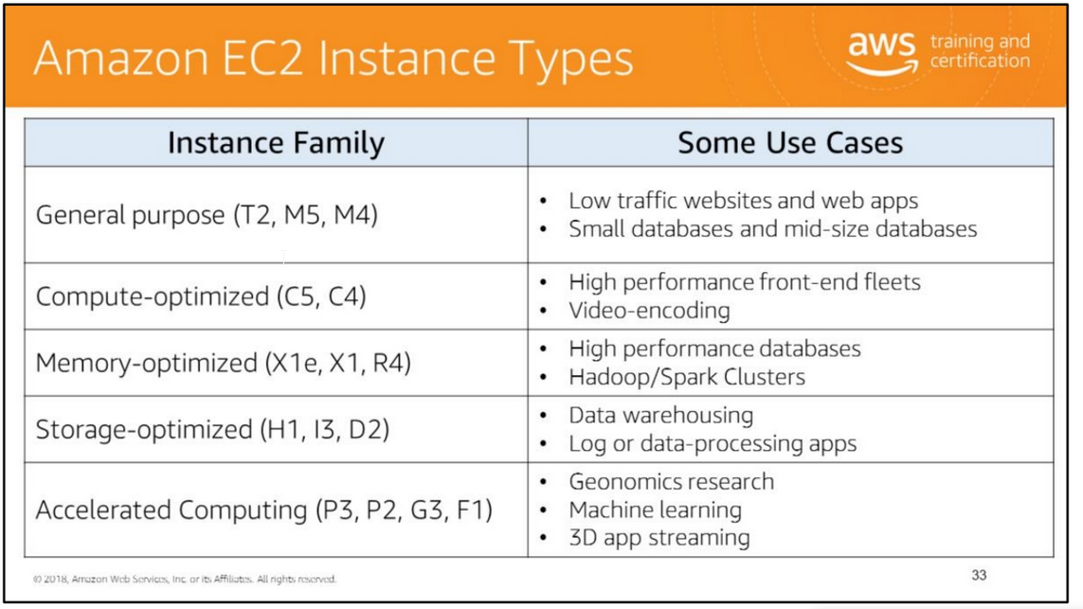
Amazon EC2 provides a wide selection of instance types optimized to fit different use cases. Instance types comprise varying combinations of CPU, memory, storage, and networking capacity and give you the flexibility to choose the appropriate mix of resources for your applications. Each instance type includes one or more instance sizes, which allows you to scale your resources to the requirements of your target workload.
When you choose your instance type you should consider the several different attributes of each family, such as number of cores, amount of memory, amount and type of storage, network performance, and processor technologies.
Another important consideration is TCO. A lowest-price-per-hour instance is not necessarily a money saver; a larger compute instance can sometimes save both money and time. It is important to evaluate all the options to see what is best for your workload.
General Purpose Instances T2 instances are a low-cost, burstable performance instance type that provide a baseline level of CPU performance with the ability to burst above the baseline. They

Slide 39
offer a balance of compute, memory, and network resources for workloads that occasionally need to burst, such as web servers, build servers, and development environments.
M5 and M4 instances provide a balance of compute, memory, and network resources. These instances are ideal for applications that require high CPU and memory performance, such as encoding applications, high traffic content management systems, and memcached applications.
Compute-Optimized Instances C5 and C4 instances are optimized for compute-intensive workloads. These instances have proportionally more CPU than memory (RAM). They are well suited to applications such as high performance web servers, batch processing, and high-performance scientific and engineering applications.
Memory-Optimized Instances This series of instances are optimized for memory-intensive workloads. These instances offer large memory sizes for high throughput applications such as high performance databases, distributed memory caches, in-memory analytics, and large enterprise deployments of software such as SAP.
Accelerated Computing Instances These instances are optimized for graphics and graphic processing unit (GPU) compute applications, such as machine learning, video encoding, and interactive streaming applications.
Storage-Optimized Instances These instances are optimized for storage and high random I/O performance, such as NoSQL databases, scale-out transactional databases, data warehousing, Hadoop, and cluster file systems.
D2 instances are optimized for storage and delivering high disk throughput. D2 instances are suitable for Massively Parallel Processing (MPP) data warehousing, MapReduce and Hadoop distributed computing, distributed file systems, and data processing applications.
For more information, see https://aws.amazon.com/ec2/instance-types/.

Slide 40
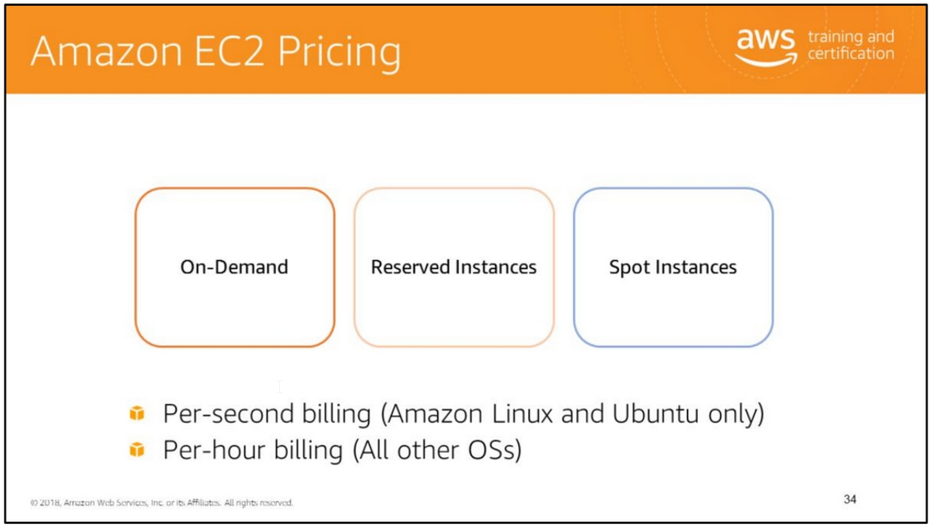
offer a balance of compute, memory, and network resources for workloads that occasionally need to burst, such as web servers, build servers, and development environments.
M5 and M4 instances provide a balance of compute, memory, and network resources. These instances are ideal for applications that require high CPU and memory performance, such as encoding applications, high traffic content management systems, and memcached applications.
Compute-Optimized Instances C5 and C4 instances are optimized for compute-intensive workloads. These instances have proportionally more CPU than memory (RAM). They are well suited to applications such as high performance web servers, batch processing, and high-performance scientific and engineering applications.
Memory-Optimized Instances This series of instances are optimized for memory-intensive workloads. These instances offer large memory sizes for high throughput applications such as high performance databases, distributed memory caches, in-memory analytics, and large enterprise deployments of software such as SAP.
Accelerated Computing Instances These instances are optimized for graphics and graphic processing unit (GPU) compute applications, such as machine learning, video encoding, and interactive streaming applications.
Storage-Optimized Instances These instances are optimized for storage and high random I/O performance, such as NoSQL databases, scale-out transactional databases, data warehousing, Hadoop, and cluster file systems.
D2 instances are optimized for storage and delivering high disk throughput. D2 instances are suitable for Massively Parallel Processing (MPP) data warehousing, MapReduce and Hadoop distributed computing, distributed file systems, and data processing applications.
For more information, see https://aws.amazon.com/ec2/instance-types/.

Slide 41
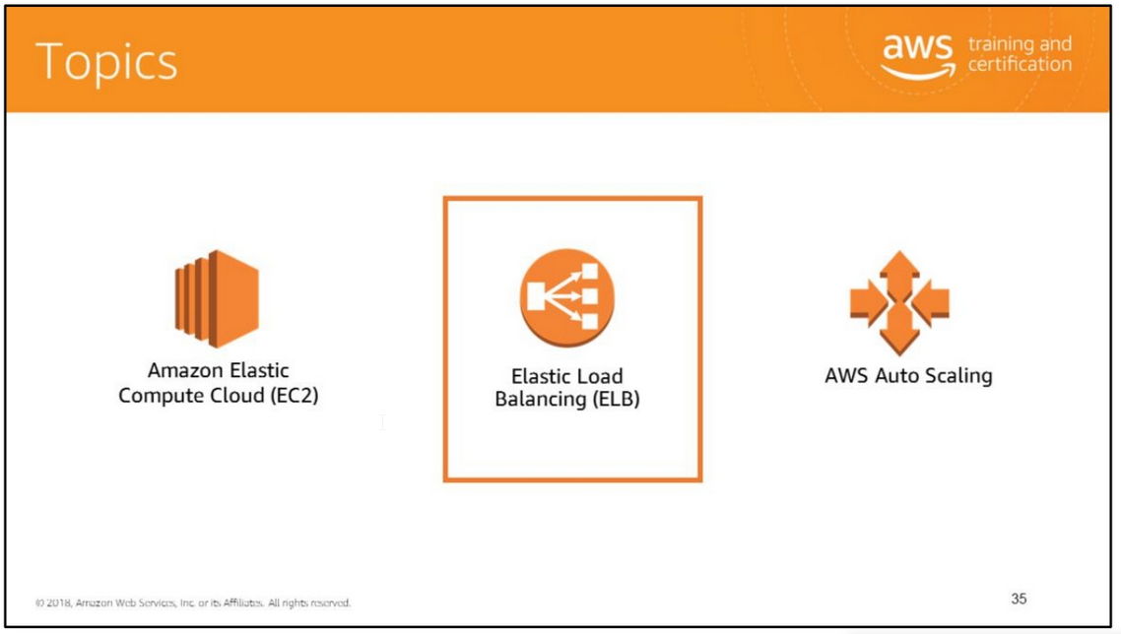
The compute services that will be covered in this module are:
• EC2
• ELB
• AWS Auto Scaling

Slide 42
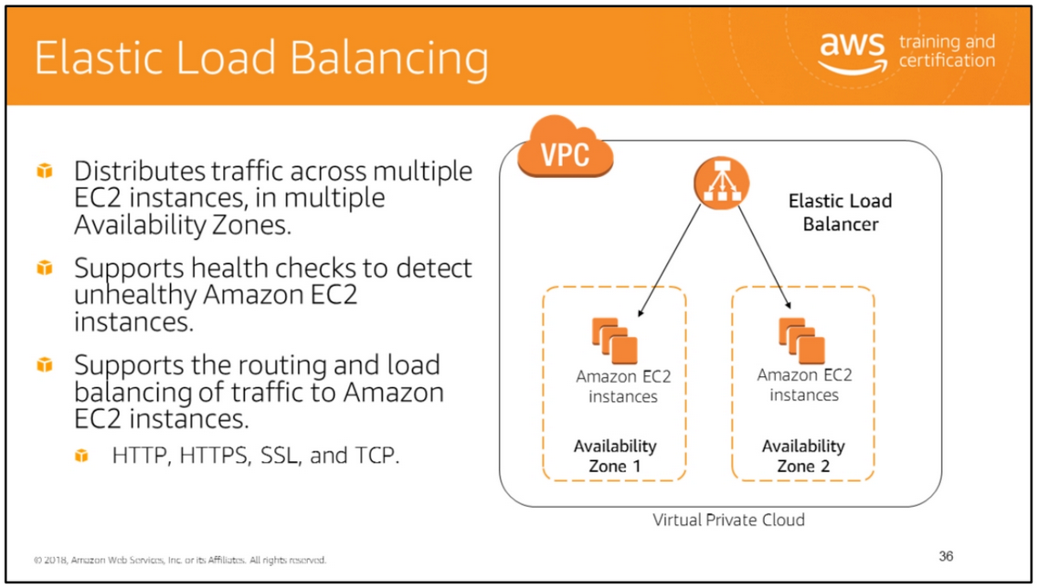
Elastic Load Balancing automatically distributes incoming application traffic across multiple targets, such as Amazon EC2 instances, containers, and IP addresses. It can handle the varying load of your application traffic in a single Availability Zone or across multiple Availability Zones.
It enables you to achieve greater fault tolerance in your applications, and seamlessly provides the amount of load balancing capacity needed in response to incoming application traffic. Elastic Load Balancing detects unhealthy instances within a pool and automatically reroutes traffic to healthy instances until the unhealthy instances have been restored. You can enable Elastic Load Balancing within a single Availability Zone or across multiple zones for even more consistent application performance.
You can access and work with your load balancer using one of the following interfaces: • AWS Management Console: A simple web browser interface that you can use to create and manage your load balancers without using additional software or tools.
• Command Line Interfaces: A Java-based command line client that wraps the SOAP

Slide 43
API.
• AWS SDKs: Language-specific APIs that take care of many of the connection details, such as calculating signatures, handling request retries, and error handling.
• Query API: Low-level API actions that you call using HTTPS requests.
For more information, see: • AWS SDKs: https://aws.amazon.com/tools/#SDKs • Application Load Balancer Query API: http://docs.aws.amazon.com/elasticloadbalancing/latest/APIReference/Welcome. html
• Classic Load Balancer Query API: http://docs.aws.amazon.com/elasticloadbalancing/2012-06-01/APIReference/Welcome.html
For more information, see https://aws.amazon.com/elasticloadbalancing/.

Slide 44
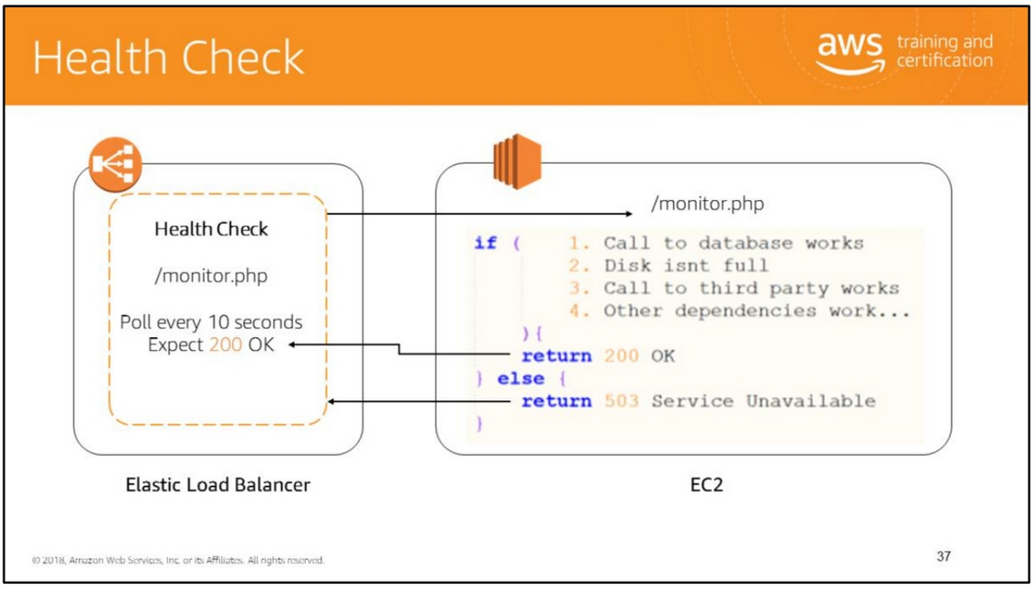
To discover the availability of your EC2 instances, a load balancer periodically sends pings, attempts connections, or sends requests to test the EC2 instances. These tests are called health checks. The status of the instances that are healthy at the time of the health check is InService. The status of any instances that are unhealthy at the time of the health check is OutOfService. The load balancer performs health checks on all registered instances, whether the instance is in a healthy state or an unhealthy state.
The load balancer routes requests only to the healthy instances. When the load balancer determines that an instance is unhealthy, it stops routing requests to that instance. The load balancer resumes routing requests to the instance when it has been restored to a healthy state.

Slide 45
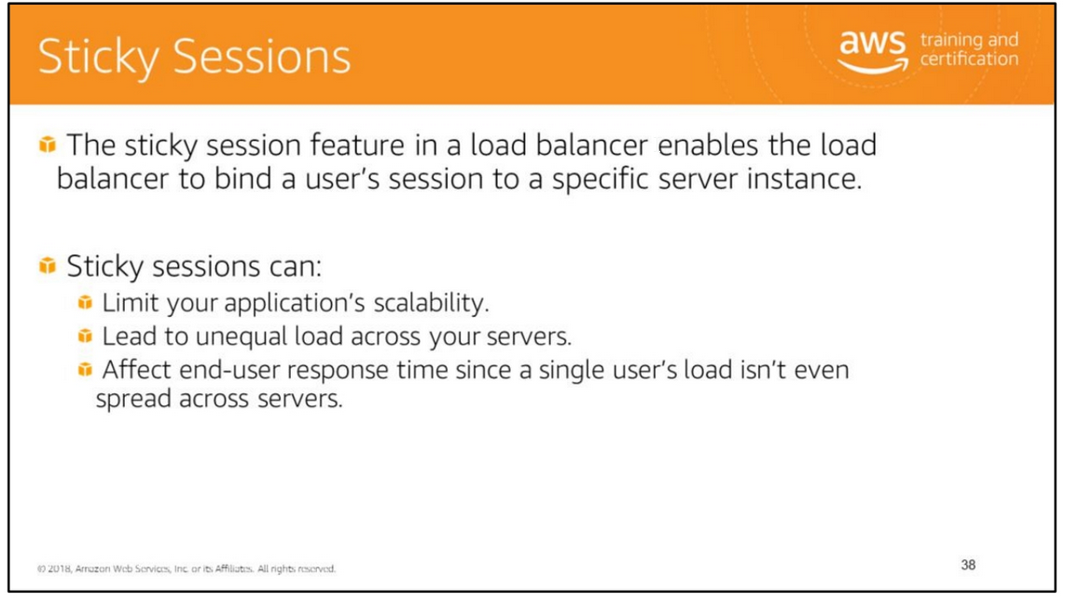
By default, a load balancer routes each request independently to the registered instance with the smallest load. However, you can use the sticky session feature (also known as session affinity), which enables the load balancer to bind a user's session to a specific instance. This ensures that all requests from the user during the session are sent to the same server instance.
Managing session data is something developers should keep in mind for better user experience. Sticky sessions can limit your application’s scalability because the load balancer is unable to truly balance the load each time it receives request from a client. With sticky sessions, the load balancer is forced to send all the requests to their original server where the session state was created even though that server might be heavily loaded and there might be another less-loaded server available to take on this request.

Slide 46
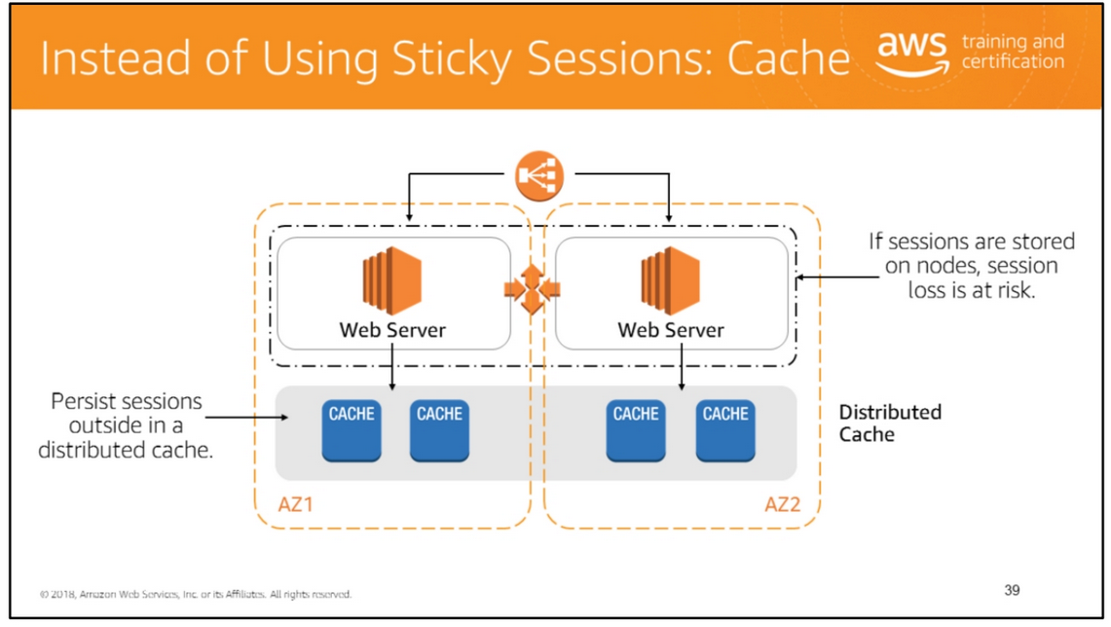
There are various ways to manage user sessions including storing those sessions locally to the node responding to the HTTP request or designating a layer in your architecture which can store those sessions in a scalable and robust manner.
Sticky sessions, also known as session affinity, allow you to route a site user to the particular web server that is managing that individual user’s session. The session’s validity can be determined by a number of methods, including a client-side cookies or via configurable duration parameters that can be set at the load balancer which routes requests to the web servers.
By default, a load balancer routes each request independently to the application instance with the smallest load. However, you can use sticky session features which enables the load balancer to bind a user’s session to a specific application instance. You can use sticky sessions for only HTTP/HTTPS load balancer listeners.
Duration-based session stickiness The load balancer uses a special load balancer–generated cookie to track the application instance for each request. When the load balancer receives a request, it first checks to see whether this cookie is present in the request. If so, the request is

Slide 47
sent to the application instance specified in the cookie. If there is no cookie, the load balancer chooses an application instance based on the existing load balancing algorithm. A cookie is inserted into the response for binding subsequent requests from the same user to that application instance. The stickiness policy configuration defines a cookie expiration, which establishes the duration of validity for each cookie. The cookie is automatically updated after its duration expires.
Application-controlled session stickiness The load balancer uses a special cookie to associate the session with the original server that handled the request, but follows the lifetime of the application-generated cookie corresponding to the cookie name specified in the policy configuration. The load balancer only inserts a new stickiness cookie if the application response includes a new application cookie. The load balancer stickiness cookie does not update with each request. If the application cookie is explicitly removed or expires, the session stops being sticky until a new application cookie is issued. Applications often store session data in memory, but this approach doesn’t scale well. Options available to manage session data without sticky sessions include: • Using Amazon ElastiCache to store session data. • Using Amazon DynamoDB to store session data.

Slide 48
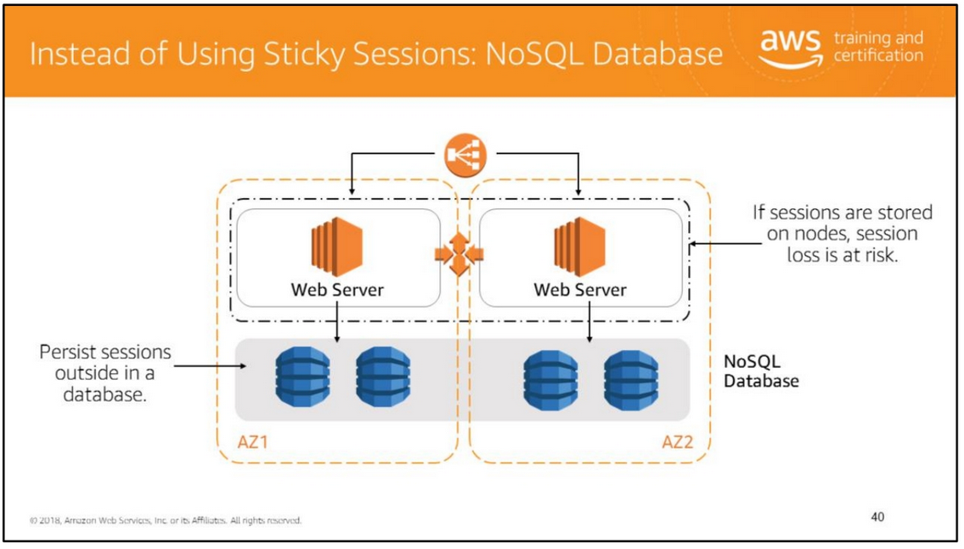

Slide 49
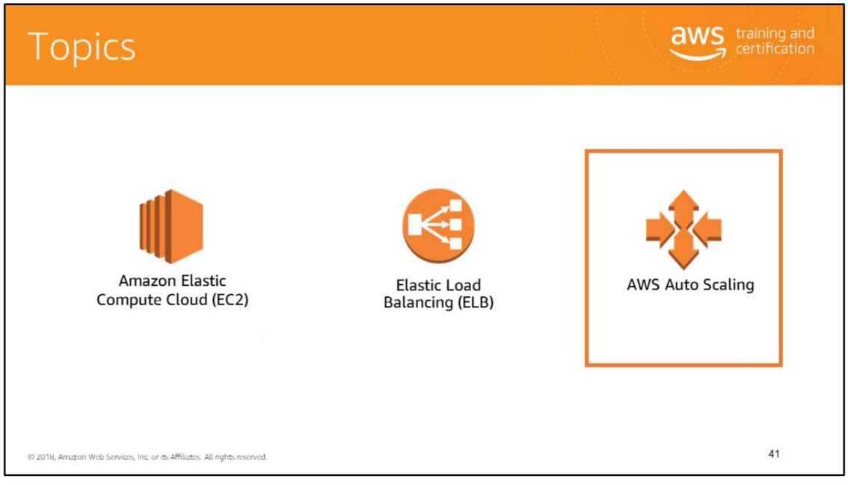
The compute services that will be covered in this module are:
• EC2
• ELB
• AWS Auto Scaling

Slide 50
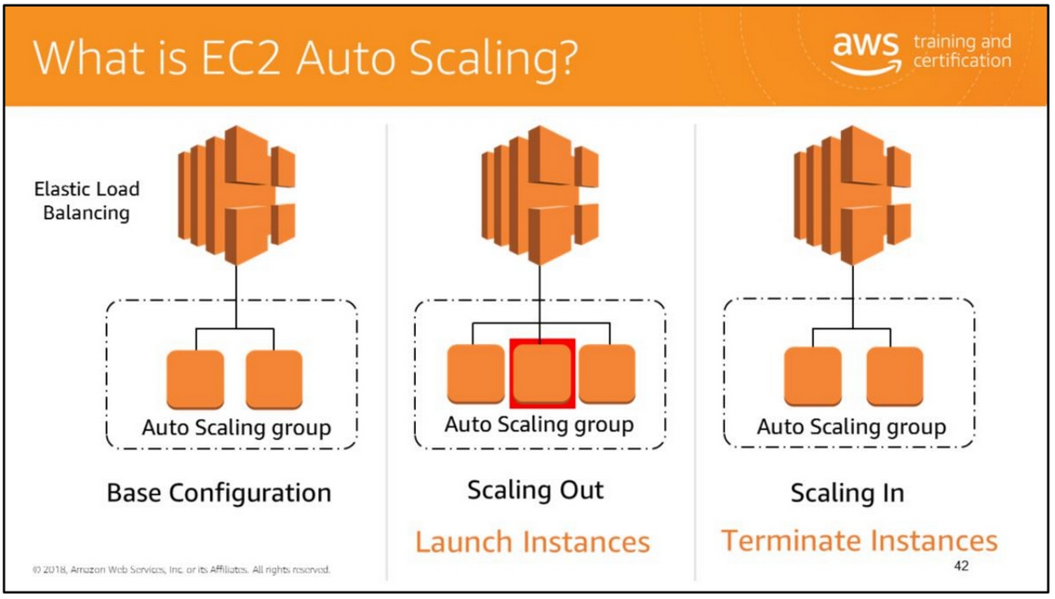
Auto Scaling helps you ensure that you have the correct number of EC2 instances available to handle the load for your application. Auto Scaling is particularly well-suited for applications that experience hourly, daily, or weekly variability in usage.
AWS Auto Scaling monitors your applications and automatically adjusts capacity to maintain steady, predictable performance at the lowest possible cost. Using AWS Auto Scaling, it’s easy to setup application scaling for multiple resources across multiple services in minutes. The service provides a simple, powerful user interface that lets you build scaling plans for resources including Amazon EC2 instances and Spot Fleets, Amazon Elastic Container Service (Amazon ECS) tasks, Amazon DynamoDB tables and indexes, and Amazon Aurora Replicas.
So what exactly is meant by scaling? The first thing you have to do is define the concepts of scaling out and scaling in. Auto Scaling can automatically adjust the number of EC2 instances running in your workload based on either conditions that you define, CPU utilization over 80%, as an example, or scheduled. If Auto Scaling adds more instances, this is termed scaling out. As Auto Scaling terminates instances, this is an example of scaling in. Remember that you have control as to what initiates these events.
For more information, see https://aws.amazon.com/autoscaling/.

Slide 51
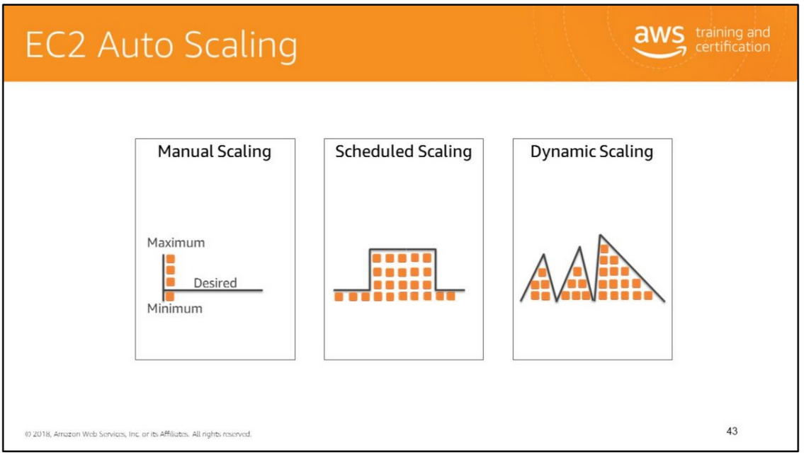
You can create collections of Amazon EC2 instances, called Auto Scaling groups. You can specify the minimum number of instances in each Auto Scaling group, and AWS Auto Scaling ensures that your group never goes below this size. You can specify the maximum number of instances in each Auto Scaling group, and AWS Auto Scaling ensures that your group never goes above this size. If you specify the desired capacity, either when you create the group or at any time thereafter, AWS Auto Scaling ensures that your group has this many instances. If you specify scaling policies, AWS Auto Scaling can launch or terminate instances as demand on your application increases or decreases. The types of AWS Auto Scaling plans available are: manual scaling, scheduled scaling, and dynamic scaling.
Manual scaling allows you to set the maximum, minimum, and desired capacity of your Auto Scaling groups.
Scheduled scaling allows you to specific the time that automatic scaling up or down of instances must take place according to predictable, recurring events.
Dynamic scaling is a more detailed scaling plan. You create a Auto Scaling policy that triggers scaling up or down of instances according to performance parameters based on network bandwidth or some other performance measure threshold.

Slide 52


Slide 53
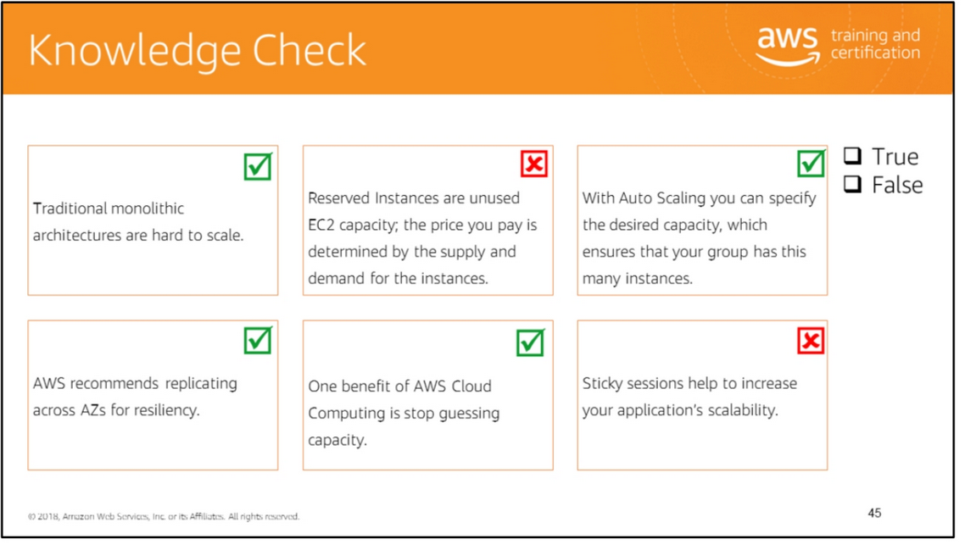
Read left to right: (True) (False) It’s not reserved instances, but spot instances are unused EC2 capacity; the price you pay is determined by the supply and demand for the instances. (True) (True) (True) (False) Sticky sessions can limit your application’s scalability because the load balancer is unable to truly balance the load each time it receives request from a client. With sticky sessions, the load balancer is forced to send all the requests to their original server where the session state was created even though that server might be heavily loaded and there might be another less-loaded server available to take on this request.

Slide 54
